Slide 1
YOLO-Based Fish Disease Detection: A Smart Lifeline for Aquaculture Farmers.
B.Sc. Final-Defense
Abdullah Al Hossain
ID : 221-15-6055
&
Anaf Fakir
ID : 221-15-4811
Department : CSE
Daffodil International University

Slide 2
Outline
Introduction
Objective
Background Study
Gap Analysis
Methodology
Results & Analysis
Novelty of the Work
Sample Dataset & Expected Output
Web Interface
Conclusion
References
B.Sc. Final-Defense

Slide 3
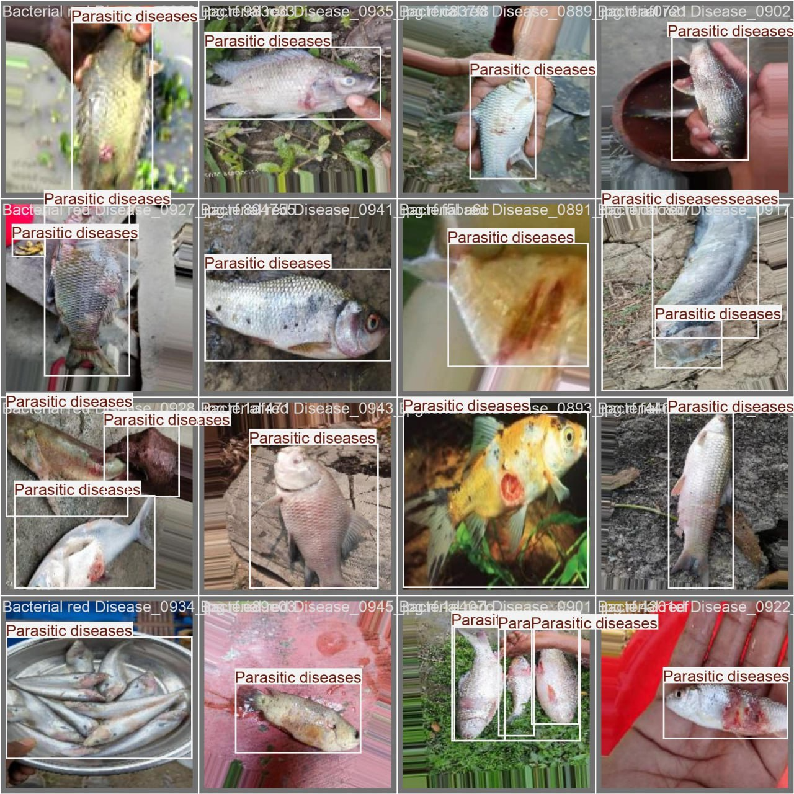
Introduction
Aquaculture is crucial for countries like Bangladesh, but fish diseases threaten its sustainability. Traditional detection is slow, costly, and often inaccurate. Our project, “YOLO-Based Fish Disease Detection: A Smart Lifeline for Aquaculture Farmers. ” offers a fast, AI-powered solution using image classification to detect seven fish conditions in real time.
B.Sc. Final-Defense

Slide 4




Objective
Disease
outbreaks
Manual
Limitation
Farmer
support
Real-time
detection
4
B.Sc. Final-Defense

Slide 5
Background Study
Paper Name | Author | Year | Model Used | Accuracy
Efficient Fish Disease Detection Using Image Processing and Machine Learning in Aquaculture | Nivin K S, Dheeraj Hebri | 2025 | CNN, Random Forest, K-Nearest Neighbor. | 87.32%
YOLO-Based Fish Detection in Underwater Environments | M. Y. Ouis, M. Akhloufi | 2023 | YOLO v8, YOLO v7 | Achieved AP50 72.47%, AP75 66.21% for v8
Fish Diseases Detection and Classification Using YOLOv8 | V. K. Yadav, S. Pal, M. Sharma, L. Paul. | 2023 | YOLO v8 | 91%
Accurate Fish Disease Classification | Y.L. Khaleel, M.A. Habeeb | 2024 | ResNet-based Deep Learning Model | 91.5%
B.Sc. Final-Defense

Slide 6
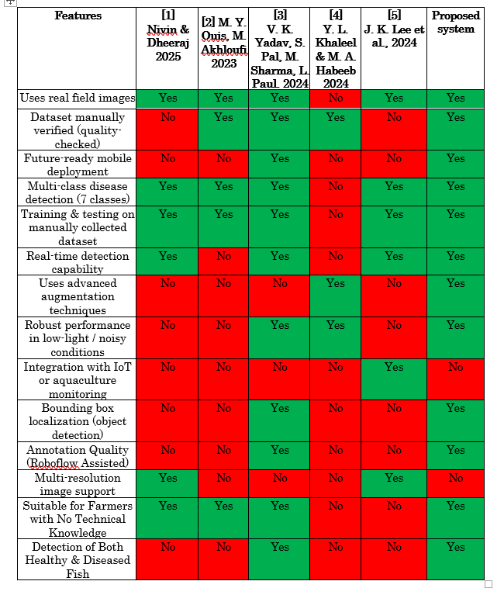
Gap Analysis
B.Sc. Final-Defense

Slide 7
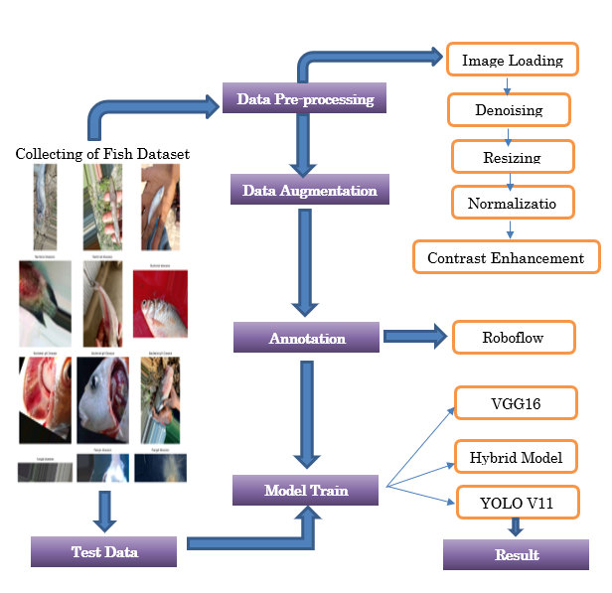
Methodology
B.Sc. Final-Defense

Slide 8
Result and Analysis
Model Name | Accuracy (%) | Precision (%) | Recall (%) | F1-Score (%) | mAP50 / mAP50-95
YOLO v11 | - | 85.35 | 89.92 | 87.60 | 91.25 / 80.03
Hybrid CNN | 65 | 69 | 66 | 65 | -
VGG16 | 91 | 84.14 | 87.60 | 86.50 | -
B.Sc. Final-Defense

Slide 9
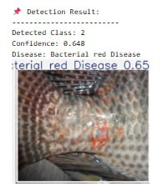
Result and Analysis
YOLO v11 detection algorithm was evaluated on a random image of the dataset which consisted of six disease classes and a healthy class. The visual patterns such as colorating, lesions, and foreign objects in fish body texture were used to analyze the image and establish the type of disease. The expected results in this test case in the model were as follows:
Detect Class: 2
Confidence Score: 0.648
The disease that is predicted is Bacterial Red Disease.
B.Sc. Final-Defense

Slide 10
Novelty of the Work
This system using a manually collected, real-field aquaculture dataset with high-quality Roboflow-assisted annotations, ensuring correctness and real-environment reliability.
A very rare model offering complete multi-class detection of 7 fish diseases with bounding-box localization, unlike previous works that provide only classification without object detection.
Designed as a future-ready solution, supporting mobile deployment and real-time inference for practical use by farmers with no technical background.
Includes both healthy and diseased fish categories, offering a more realistic and practical monitoring system compared to earlier models that focus only on diseased samples.
B.Sc. Final-Defense

Slide 11
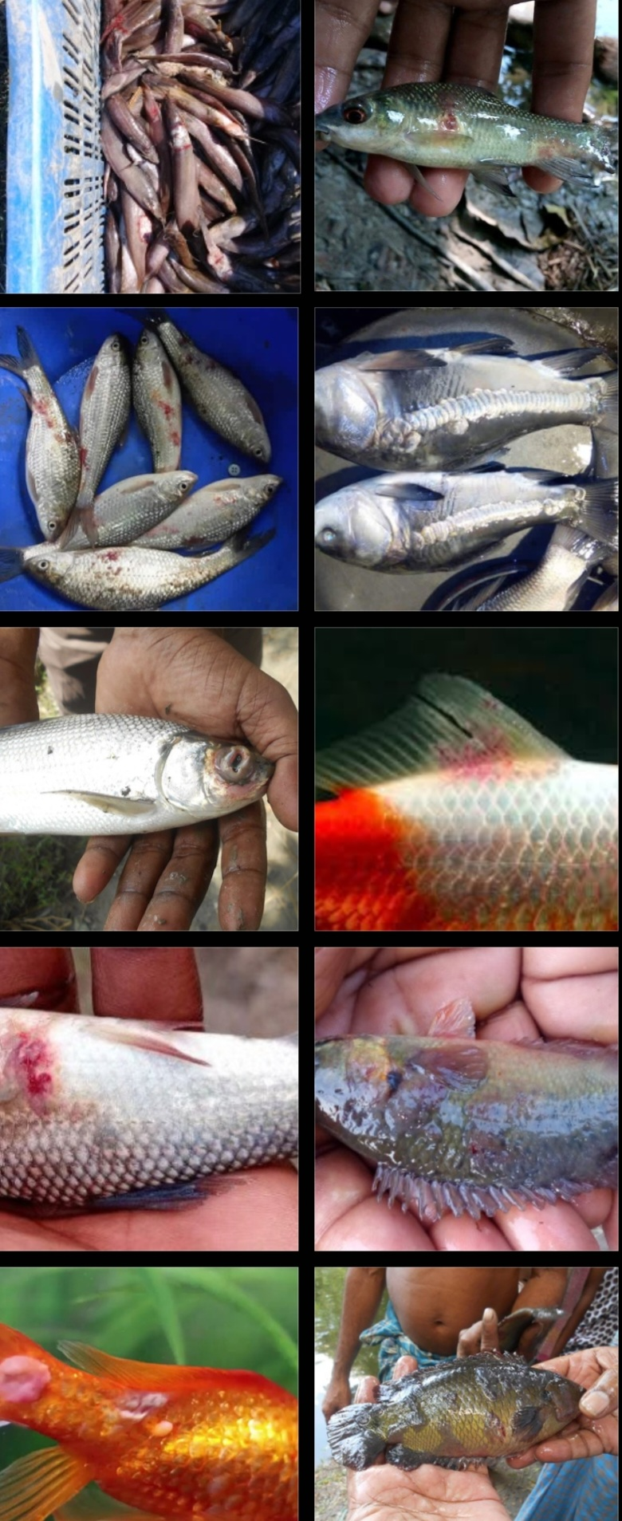
Sample dataset
Class | Raw | Augmented
Healthy fish | 364 | 1231
Bacterial Gill Disease | 119 | 1229
Parasitic diseases | 82 | 1000
Bacterial Red disease | 496 | 1250
Viral White Tail disease | 113 | 1000
General Bacterial diseases | 125 | 1000
Fungal diseases | 107 | 1000
B.Sc. Final-Defense

Slide 12
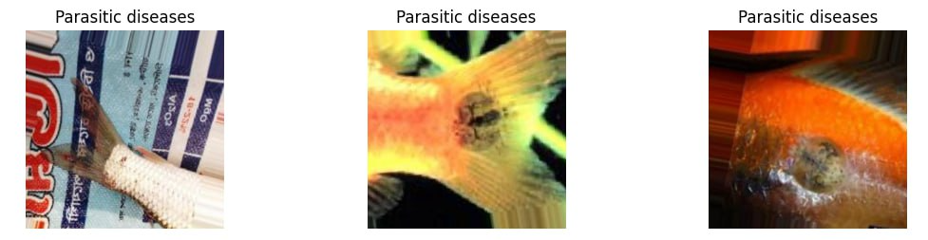
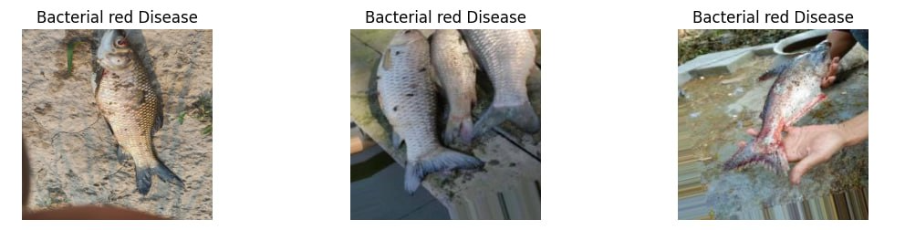
Sample dataset and Expected output
B.Sc. Final-Defense

Slide 13
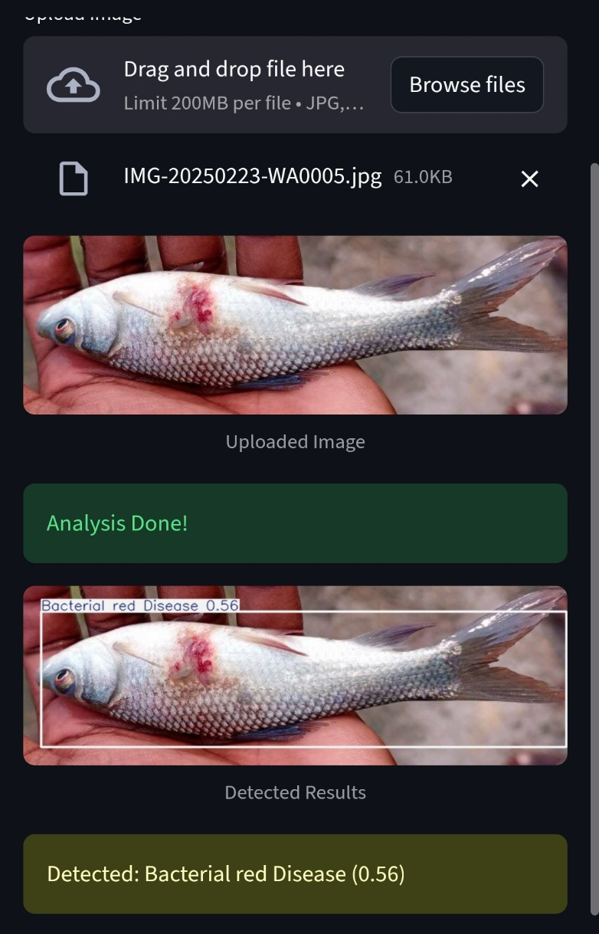
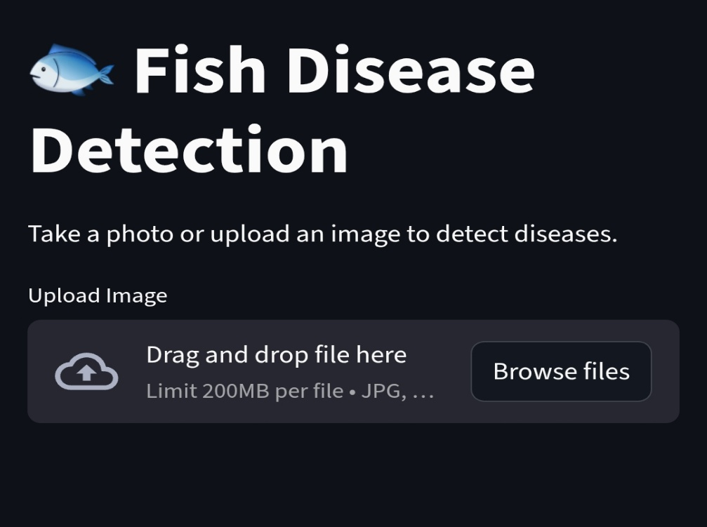
Web Interface of Image Enhancement
B.Sc. Final-Defense

Slide 14
Conclusion
Our study highlights the importance of early and accurate fish disease detection to prevent large-scale losses in aquaculture.
Further research can focus on expanding datasets, improving model accuracy.
Our work contributes to bridging the gap in automated fish disease detection, paving the way for smarter and more efficient aquaculture management.
B.Sc. Final-Defense

Slide 15
References
[1] Nivin K S and Dheeraj Hebri, "Efficient Fish Disease Detection Using Image Processing and Machine Learning in Aquaculture," in Proc. of the International Conference on Sustainable Aquaculture Technologies, May 2025.
[2] M. Y. Ouis and M. Akhloufi, “YOLO-Based Fish Detection in Underwater Environments,” in Proc. of the International Conference on Underwater Imaging and Aquatic Vision Systems, 2023.
[3] V. K. Yadav, S. Pal, M. Sharma, L. Paul, A. A. Sambhe, and A. D. Deo, “Fish Diseases Detection and Classification Using YOLOv8,” in Proc. of the International Conference on Intelligent Computing and Smart Agricultural Systems, 2024.
[4] Ashmi Anees and Amal K Jose, "Machine Learning Based Fish Disease Detection in Aquaculture," Proceedings of the National Conference on Emerging Computing and Engineering Applications (NCECA), 2025.
[5] R. B. Mahmud and M. S. Sadad, " An in-depth automated approach for fish disease recognition," 2023 International Journal of Computer Applications, 2023.
[6] Y. L. Khaleel and M. A. Habeeb, "Accurate Fish Disease Classification," Journal of Applied Computer Science, 2024.
[7] J. K. Lee, H. S. Kim, and S. W. Park, "Deep Learning Approaches for Fish Disease Recognition in Aquaculture," IEEE Access, vol. 12, pp. 123456-123465, 2024.
[8] M. T. Islam and N. Ahmed, "Automated Detection of Fish Diseases Using Convolutional Neural Networks," Journal of Aquatic Informatics, vol. 9, no. 2, pp. 75-85, 2024.
[9] L. Zhang, X. Wang, and J. Chen, "A Novel Hybrid Model for Fish Disease Diagnosis Based on Image Processing," International Journal of Agricultural and Biological Engineering, vol. 17, no. 4, pp. 210-218, 2024.
[10] R. Gupta and P. Sharma, "Real-Time Fish Disease Identification Using Mobile Vision System," Proceedings of the International Symposium on Computer Vision and Image Processing, 2023.
B.Sc. Final-Defense

Slide 16
THANK YOU
B.Sc. Final-Defense

